Slide 1
Software Lab Presentation - Group 25
Munich, 5th December 2025
TUM School of Engineering and Design
Speaker: Nien-Ying (03803153)

Slide 2

Festo Plant for Discrete Manufacturing:
Developing Simulation Models for Industrial Copilot
Presentation by MSc. Computational Mechanics students:
Adrián Almohalla (03804037)
Eduardo Silva (03805057)
Nien-Ying Lin (03803153)
Monitored and coordinated by:
Mohamed Khalil
Speaker: Nien-Ying (03803153)

Slide 3
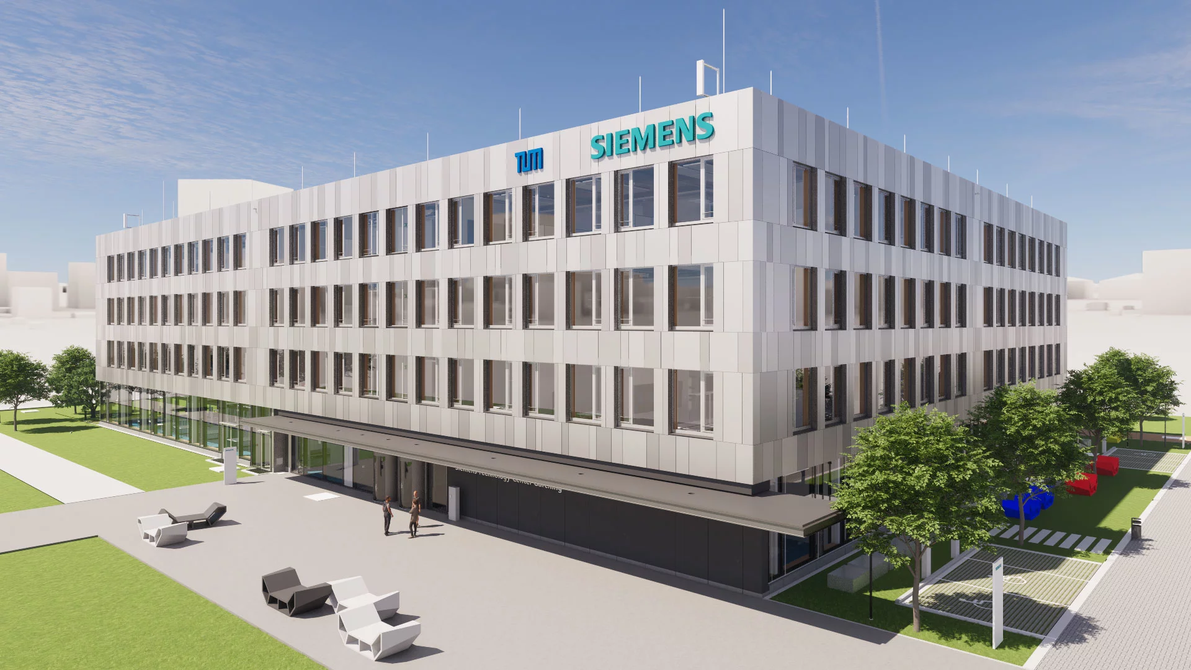

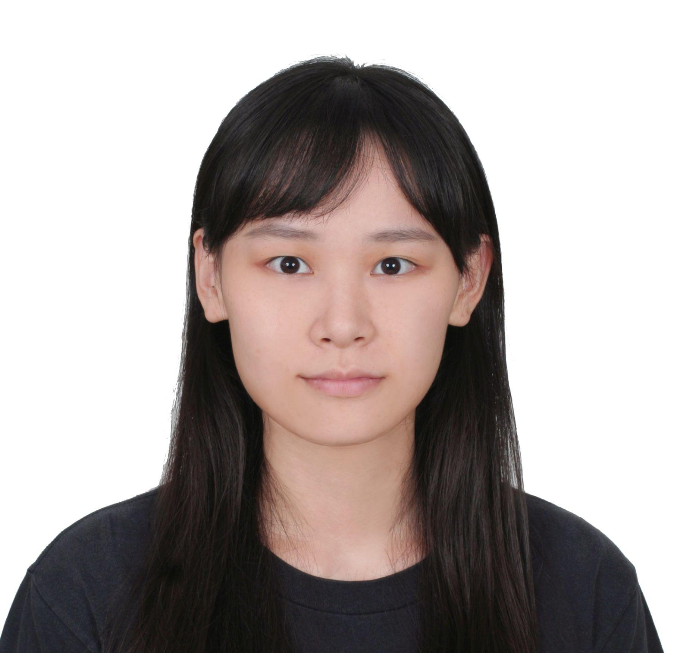


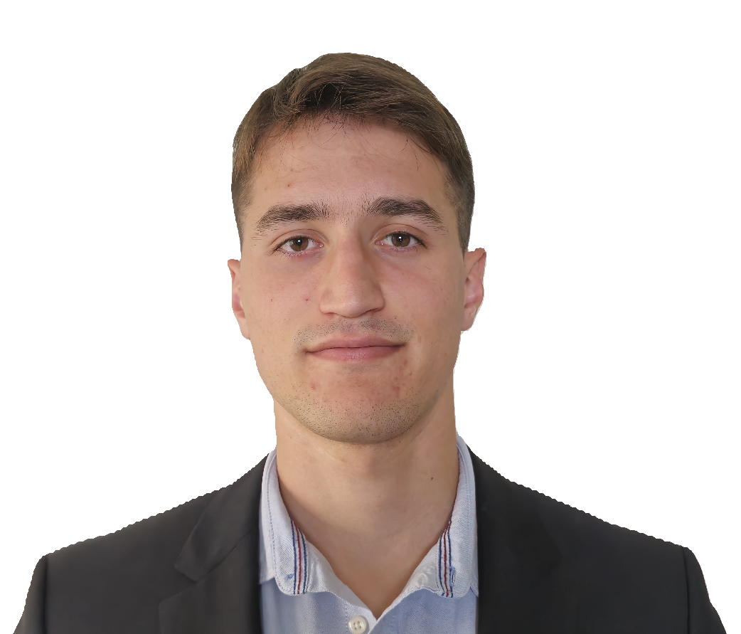
Quick Recap About Team
Siemens Technology Center (Garching)
Eduardo Silva
Nien-Ying Lin
Mohamed Khalil
khalil.mohamed@siemens.com
Adrián Almohalla
Speaker: Nien-Ying (03803153)

Slide 4





Quick Recap
Overview
Quality Tool
Degradation Tool
Agentic System
Results and Next Steps
Speaker: Nien-Ying (03803153)

Slide 5
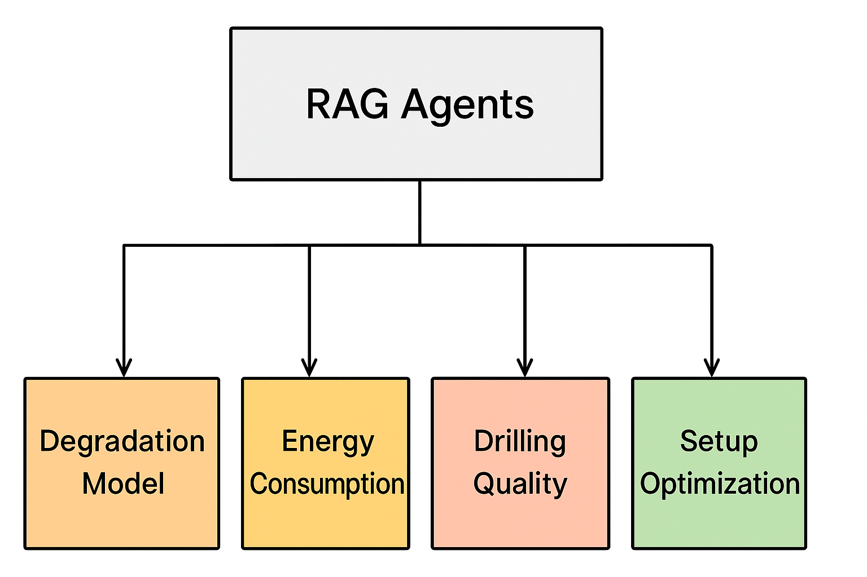
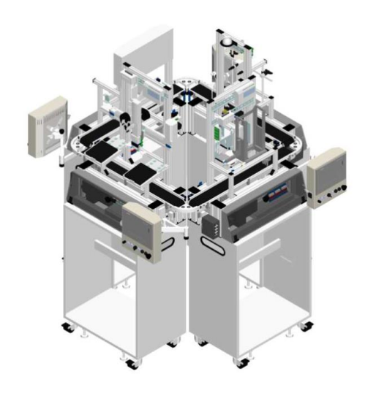
Recap - Problem
Manufacturing involves process (feed rate, torque) and product (material) parameters
Existing simulation tools are complex and not accessible to non-experts
Fig. 2 - RAG-LLMs Tools
Fig.1 - Festo Plant Drilling Station
Speaker: Nien-Ying (03803153)
Notes:
Explain here what the problem is.
Use the documents from Siemens that they gave us for the software lab to explain what the problem is.

Slide 6





Recap - Example User Case
“How much wear can I expect this production order to cause to my drilling tools?
“If I use X material, how does it change the quality of my drilling? And how can I optimize it?”
Fig. 3 - User Case Icons
Speaker: Nien-Ying (03803153)

Slide 7
Recap - Dataset
[1]
Feature | Unit | Description
ID | — | Unique identifier for each row
vc (Cutting speed) | m/min | Generated: Walter GPS
n (Spindle speed) | 1/min | Calculated: (vc × 1000)/(π × D)
f (Feed) | mm/rev | Generated: Walter GPS
vf (Feed rate) | mm/min | Calculated: f × n
Pc (Power) | kW | Calculated: (F × vc)/1000
Cooling | % | Assigned: 0, 25, 50, 100
Material | — | Assigned: P(C45K), K(GJL-250), N(AlSi alloy)
Drill Bit type | — | Assigned(DIN 1836): N(for C45K), H(for GJL-250), W(for AlSi alloy)
t (Process Time) | sec | Generated: Walter GPS
20,000 synthetic drilling operations
Each row contains:
10 features, 5 failure labels
Fixed drilling target: blind hole (⌀12 mm, depth 60 mm)
Failure Labels | Unit | Description
Main Failure | binary | Rule-based: 1 if any subgroup failure occurs
Build-up Edge | binary | Rule-based: Low vc + low cooling
Compression Chips | binary | Rule-based: ≥2 of: high vf, low cooling, wrong bit
Flank Wear | binary | Rule-based: High vf + low vc
Wrong Drill Bit | binary | Rule-based: Bit–Material mismatch
D: drill bit diameter, F: drilling force
Speaker: Nien-Ying (03803153)

Slide 8
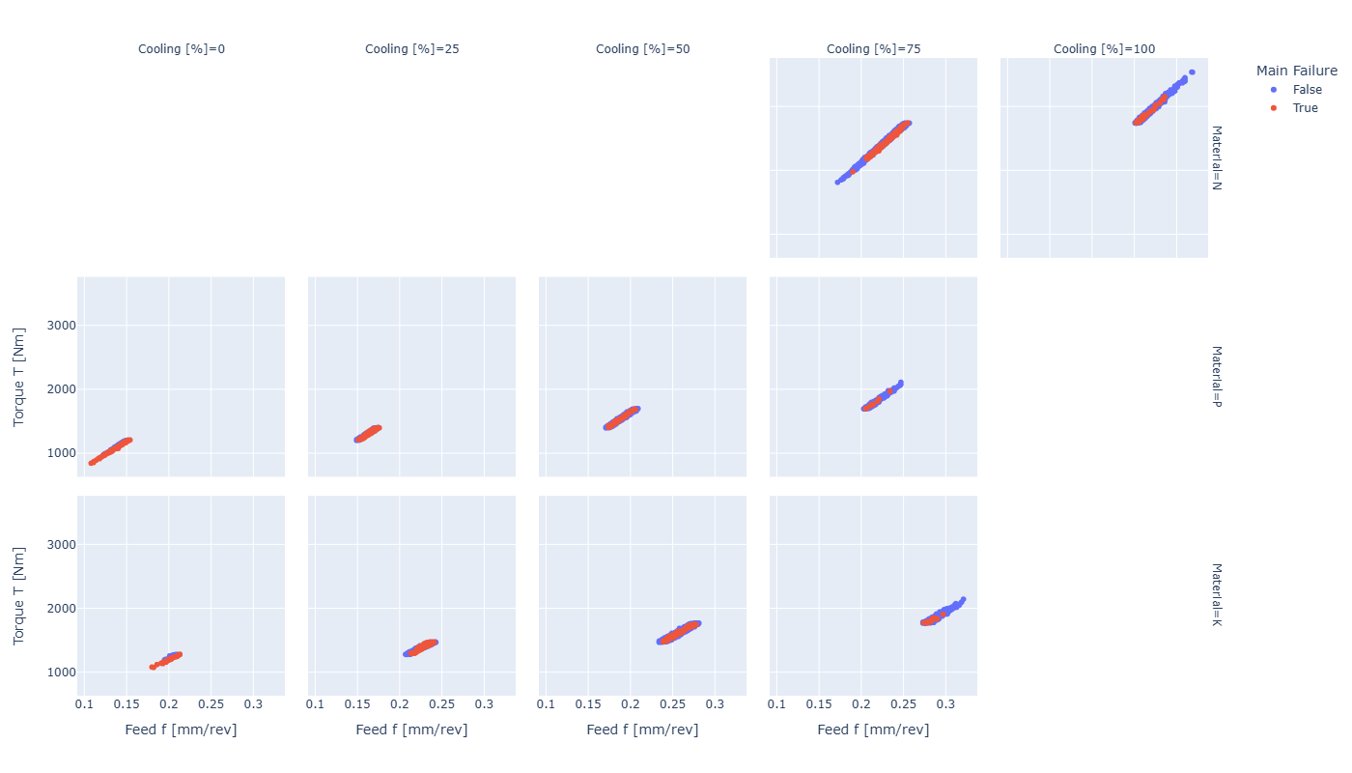
Recap - Torque Prediction
Cooling
Feed has the strongest influence on torque
→ nearly linear increase
Material type shifts torque levels
Linear Regression Model
Feed + One material property
Material
Torque [Nm]
Torque [Nm]
= 2727.15
+ 2338.64 × Feed f [mm/rev]
- 9.98 × Hardness [Brinell]
Feed [mm/rev]
Fig. 4 - Torque vs. Feed across materials and cooling levels, colored by failure status.
Speaker: Nien-Ying (03803153)

Slide 9
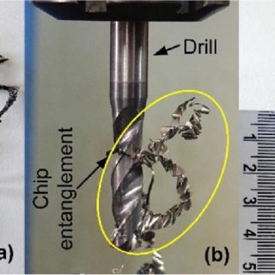
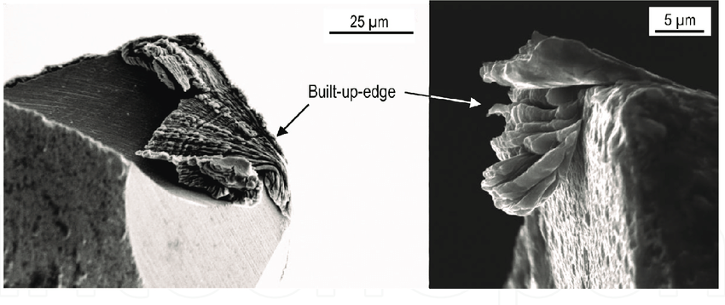
Quality Tool
Failure Type: BEF(Built-up edge failure), CCF(Compression chips failure)
Motivation: improve process reliability and reduce tool & material costs
Goal: build simple, interpretable rules for the agent
[2] Fig. 5 - Built-Up Edge on Cutting Tool
[3] Fig. 6 - Chip Accumulation / Entanglement during Drilling
Speaker: Nien-Ying (03803153)

Slide 10
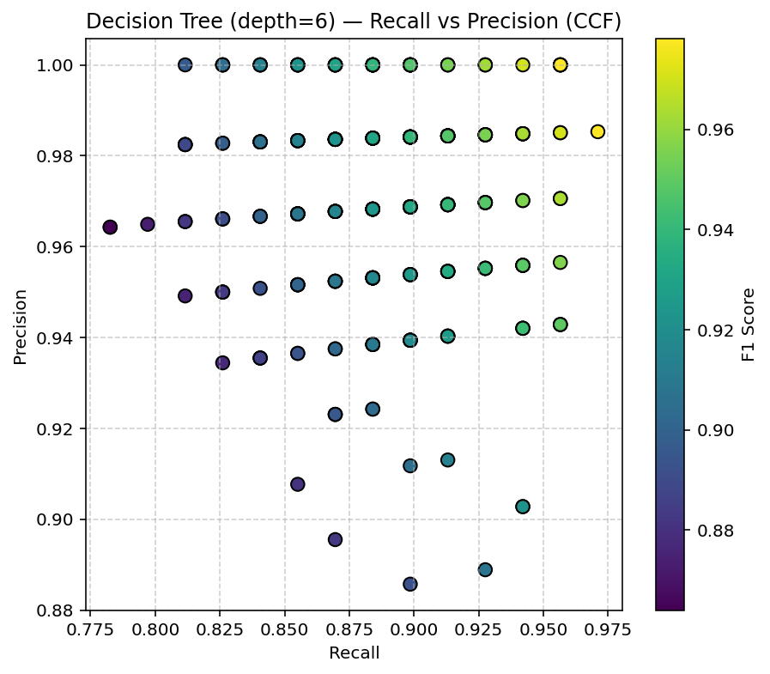
Quality Tool - Method
Model: Decision Tree
Features:
full features (except failures)
selected feature
Target (Label):
BEF/CCF
Problem: Dataset is imbalanced
Rule extraction: extract + manual adjustment
Fig. 7 - Effect of Split Seed on Recall and Precision (CCF)
Speaker: Nien-Ying (03803153)

Slide 11
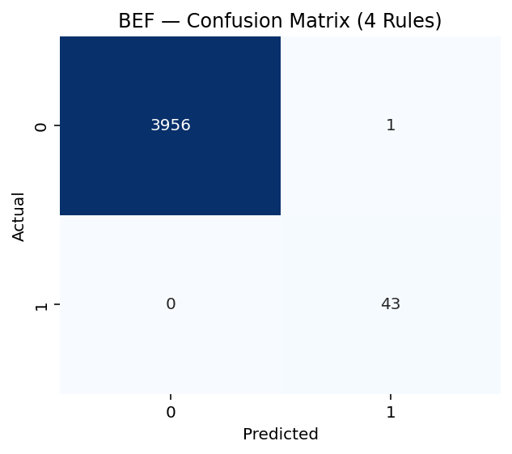


Quality Tool - Result
BEF (4 rules)
Precision : 0.977 Recall : 1.000 F1 : 0.989
CCF (8 rules)
Precision : 0.958 Recall : 1.000 F1 : 0.979
CCF (4 rules)
Precision : 0.970 Recall : 0.942 F1 : 0.956
Fig. 8 - Rule-Based Quality Tool – BEF and CCF Results (0 = OK; 1 = Failure)
Speaker: Nien-Ying (03803153)

Slide 12
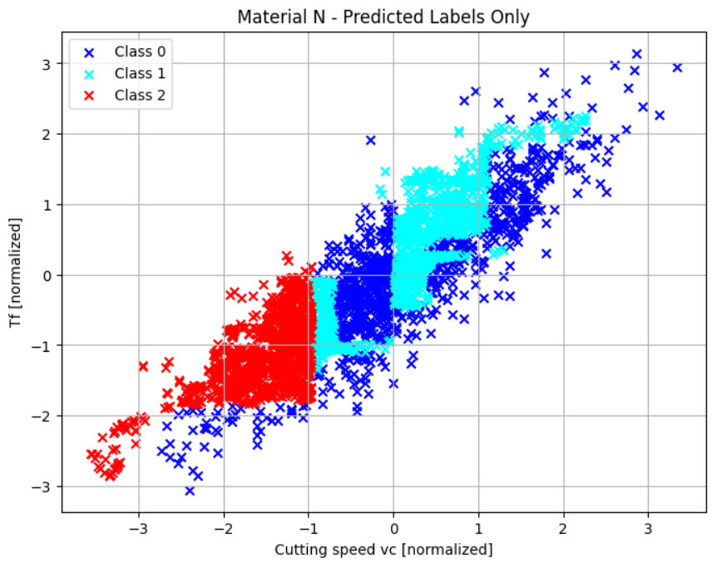
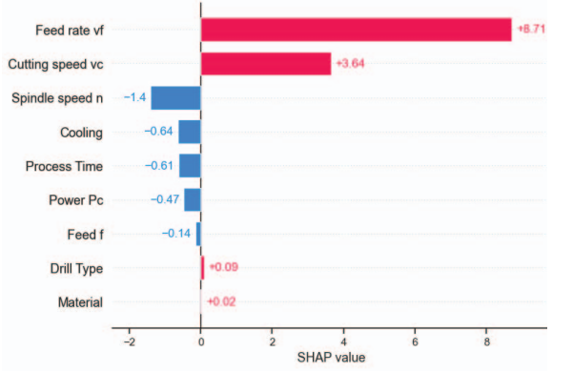
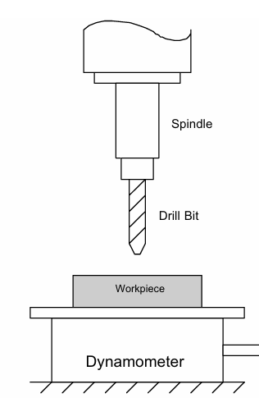
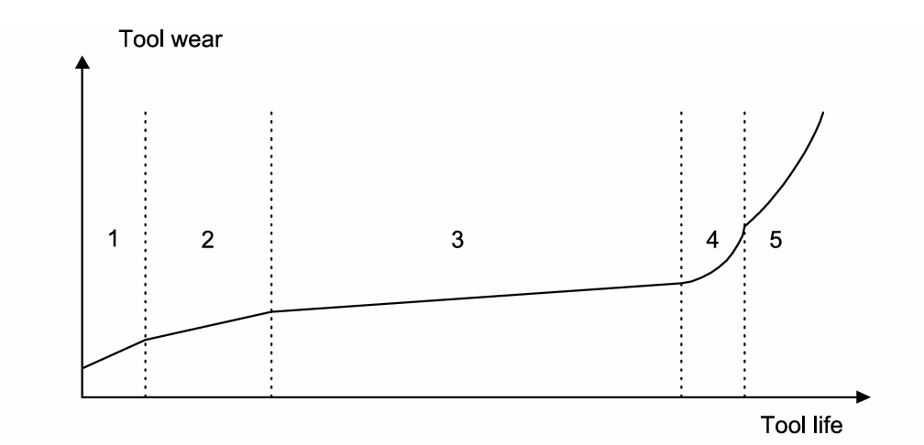
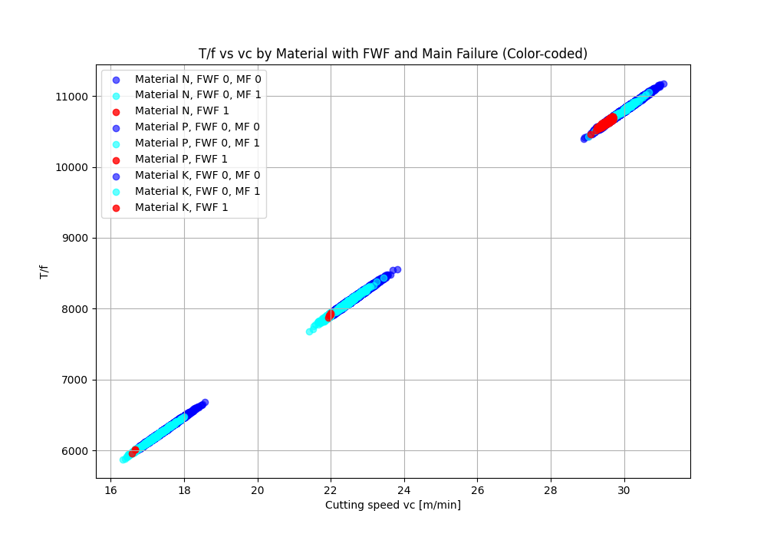
Degradation Tool Recap
Tool wear evolution graph:
Fig. 12 TreeSHAP feature importance bar respect to wear
Drill bit to measure the wear:
Fig. 11 Wear classification before cleaning data
Class 0
(almost no wear)
Class 1
(between 10-99% wear)
Class 2
(worn)
Fig. 9 Experimental setup
Fig. 10 Tool wear evolution
Speaker: Adrián (03804037)

Slide 13
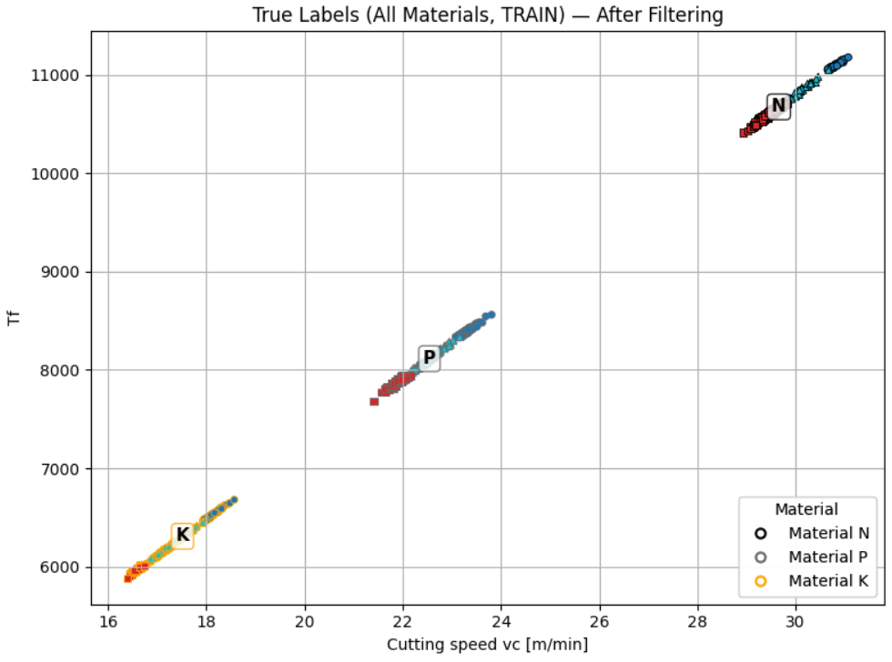
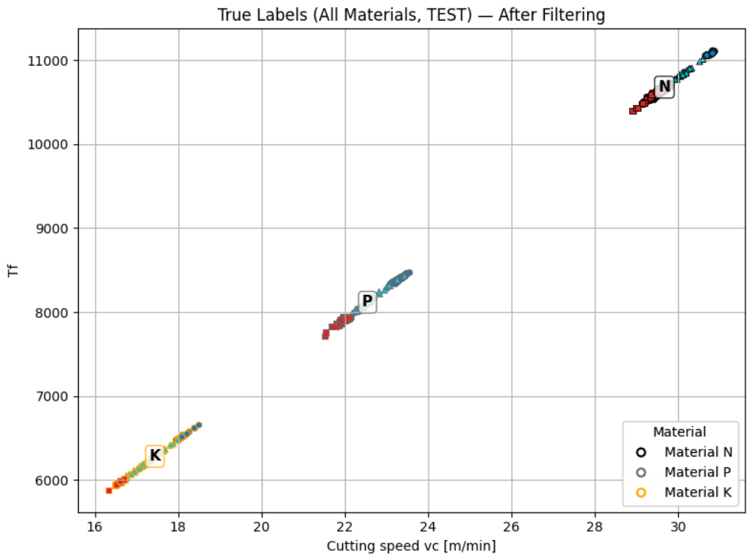
Degradation Tool
The dataset is first filtered using rule-based domain constraints that enforce physical consistency.
Only after this filtering step, the data is randomly split into training (70%) and test (30%) subsets:
Fig. 13 and 14 Wear classification after filtering data of Train and Test set
Speaker: Adrián (03804037)

Slide 14
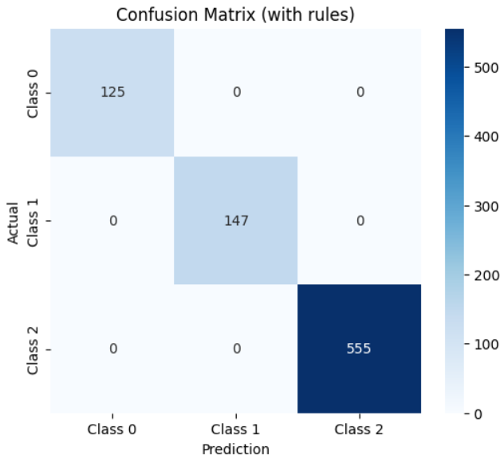
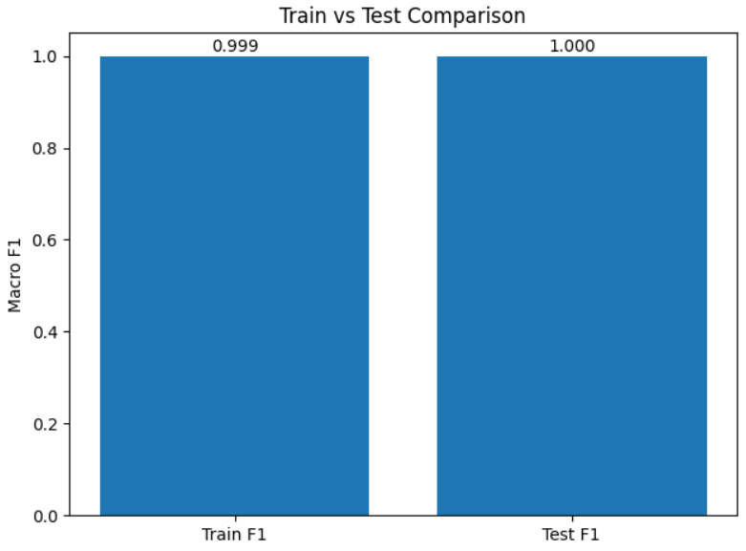
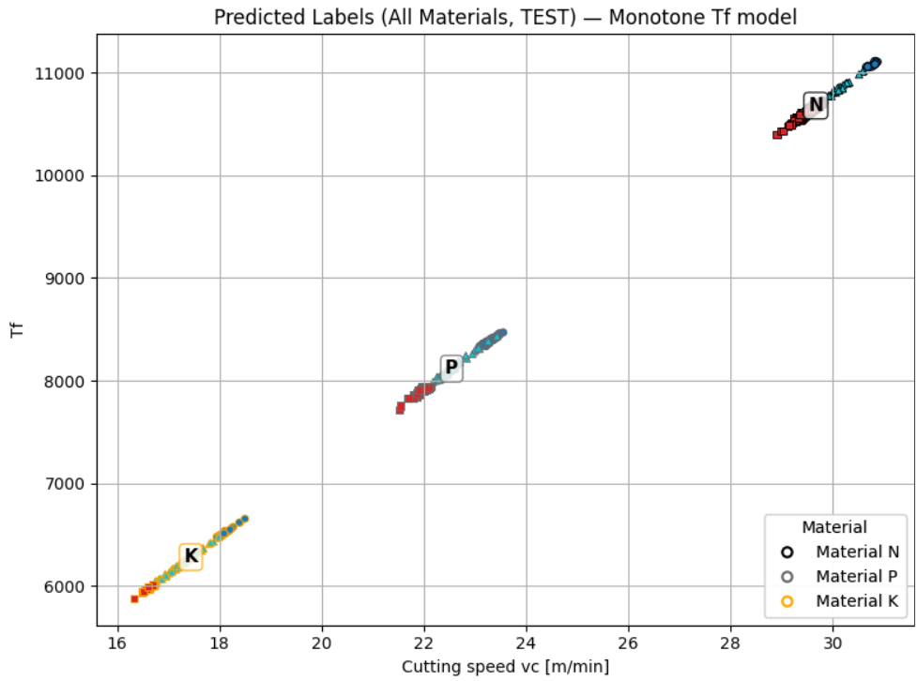
Degradation Tool
Final results from degradation tool:
Fig. 15 Confusion Matrix
Fig. 16 F1-score for Train and Test set
Fig. 17 Predicted wear for the different materials from dataset
Speaker: Adrián (03804037)
Notes:
The macro-F1 score is slightly lower on the training set (0.999) than on the test set (1.000), which is a desirable situation because it indicates that the model is not memorizing the training data but generalizes well to unseen samples. The small difference results from the rule-based physical correction applied after the model prediction, which can occasionally fix a borderline training sample. Perfect class separation with zero misclassification. Model generalizes well and does not overfit. Three zones perfectly defined.

Slide 15
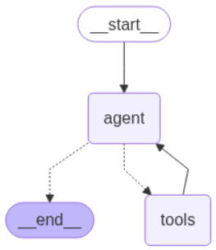
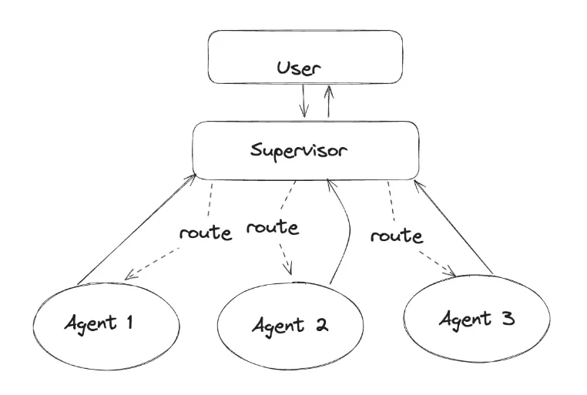
Agentic System Pipeline
Degradation and Quality tools developed
How to implement and fine-tune them into the:
Single-Agent System
Multi-Agent System
Fig. 18 - Single Agent
Fig. 19- Multi-Agent
Speaker: Eduardo (03805057)
Notes:
Explain here what the problem is.
Use the documents from Siemens that they gave us for the software lab to explain what the problem is.

Slide 16
Agentic System Pipeline
Dataset
Agentic System:
Single Agent
Multi Agent
LLM Choice
v
Tools
Prompts (Instructions)
Speaker: Eduardo (03805057)
Notes:
Explain here what the problem is.
Use the documents from Siemens that they gave us for the software lab to explain what the problem is.

Slide 17
Agentic System Pipeline
LLM Choice
2) Prompt Engineering
3) Agentic Architecture
Dataset
Agentic System:
Single Agent
Multi Agent
LLM Choice
v
Tools
Prompts (Instructions)
Speaker: Eduardo (03805057)
Notes:
Explain here what the problem is.
Use the documents from Siemens that they gave us for the software lab to explain what the problem is.

Slide 18

User Queries
First step is to create a batch of user queries.
Queries subdivided between levels of difficulty: EASY, MEDIUM and HARD
11 queries in total
Speaker: Eduardo (03805057)
Notes:
Explain the difference between EASY, MEDIUM and HARD

Slide 19
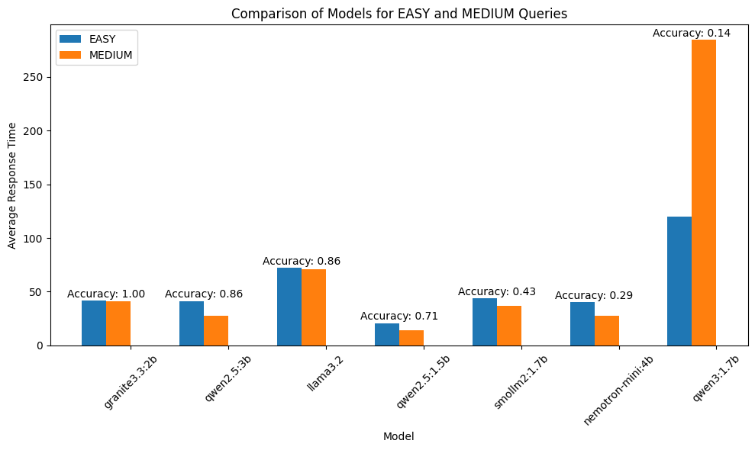
LLM Selection
Usage of “Neutral Prompt”
24 LLMs imported from Ollama
Only 7 work with RAM constraint
Selected Granite3.3:2B
Fig. 20 - LLMs Choice
Speaker: Eduardo (03805057)
Notes:
Explain here what the problem is.
Use the documents from Siemens that they gave us for the software lab to explain what the problem is.

Slide 20
Single Agent Prompt vs Multi-Agent Prompts
Only 1 Prompts for the System!
Fig. 21 - Single Agent vs Multi Agent Prompts
Speaker: Eduardo (03805057)
Notes:
Explain here what the problem is.
Use the documents from Siemens that they gave us for the software lab to explain what the problem is.

Slide 21
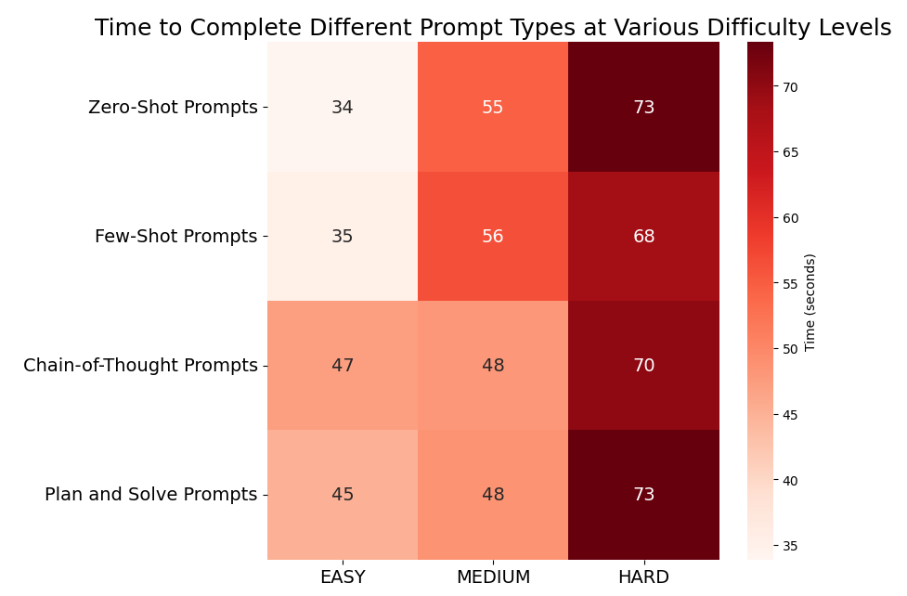
Prompt Engineering - Single Agent
Using Granite3.3:2B
Zero and Few Shot show drastic increase for Medium and Hard Queries.
CoT shows the more stable behaviour.
Selected Chain-of-Thought
Speaker: Eduardo (03805057)
Notes:
Explain here what the problem is.
Use the documents from Siemens that they gave us for the software lab to explain what the problem is.

Slide 22
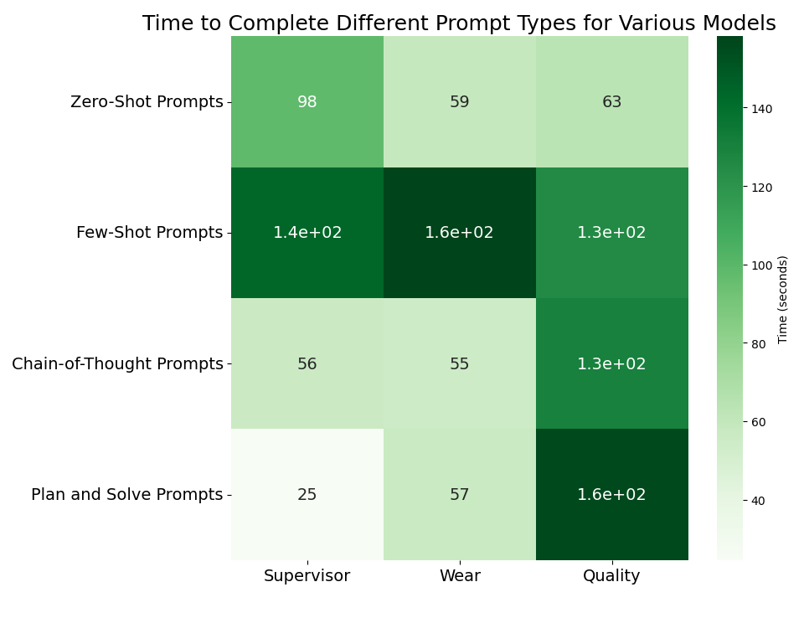
Prompt Engineering - Multi Agent
Averaged Difficulties over Prompts
Supervisor good at “Planning and Solving”
Tools better at Zero-Shot
Select Plan and Solve and Zero-Shot
Speaker: Eduardo (03805057)
Notes:
Explain here what the problem is.
Use the documents from Siemens that they gave us for the software lab to explain what the problem is.

Slide 23
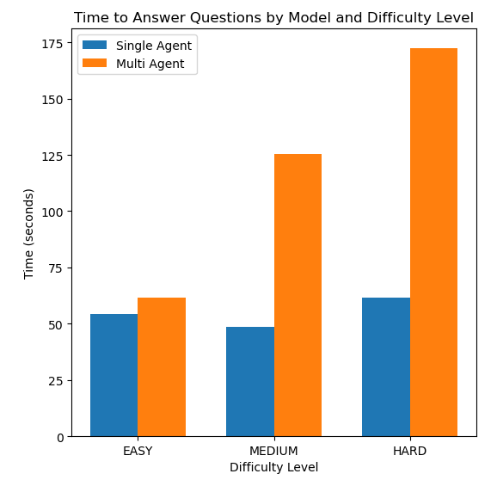
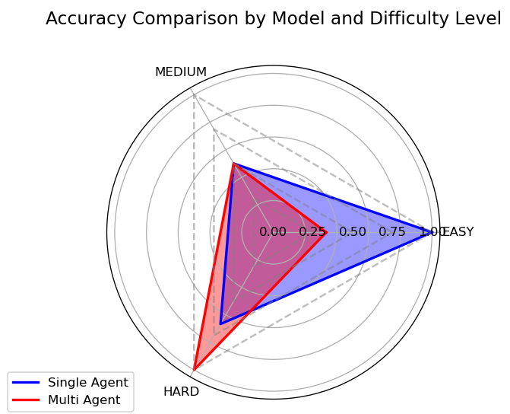
Comparison Between Architectures
Single Agent better at time performance!
Multi Agent better at harder questions!
Choice depending on application.
Speaker: Eduardo (03805057)
Notes:
Explain here what the problem is.
Use the documents from Siemens that they gave us for the software lab to explain what the problem is.

Slide 24


Results and Limitations:
Tools correctly predict wear and quality
Single and Multi-Agent Systems
Interface for Inexperienced Users
Restrained to dataset materials
Unstable accuracy and responses
Still required some knowledge about drilling process
Speaker: Eduardo (03805057)
Notes:
Explain here what the problem is.
Use the documents from Siemens that they gave us for the software lab to explain what the problem is.

Slide 25
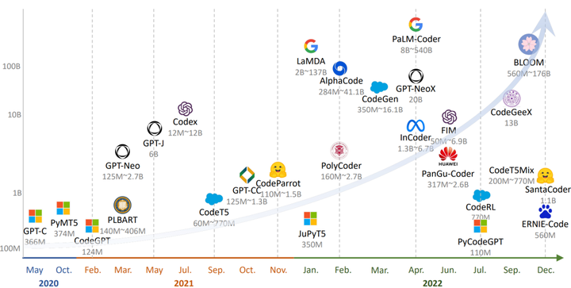
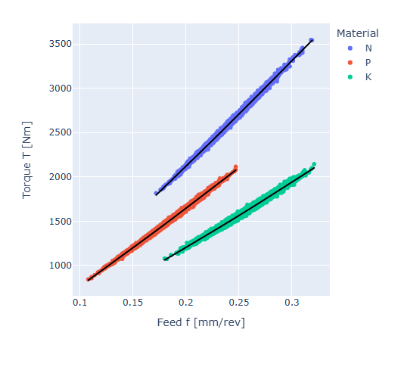
Next Steps
Understand that LLMs are still black-boxes (no guarantee that state found is the best one).
Expand with more tools (energy consumption produced by Siemens; drilling setup optimization, …)
Incorporate Torque prediction for new materials into the LLM and not depend only in datasets.
Update regularly libraries and LLMs and integrate with API endpoints for frontend visualization.
Speaker: Eduardo (03805057)
Notes:
Explain here what the problem is.
Use the documents from Siemens that they gave us for the software lab to explain what the problem is.

Slide 26

Documentation and Literature
Refer to our Github to get all the code, reports and documentation!
QR code leads to our Github repository.
Speaker: Eduardo (03805057)

Slide 27
References
[1] - Explainable Artificial Intelligence in Mechanical Engineering: A Synthetic Dataset for Comprehensive Failure Mode Analysis http://dx.doi.org/10.1109/TransAI60598.2023.00032
[2] Micromachining of Advanced Materials https://www.researchgate.net/figure/Built-up-edge-at-the-cutting-edge-on-a-microdrilling-tool-left-and-micromilling-tool_fig5_337043152
[3] Comparison of conventional drilling and helical milling for hole making in Ti6Al4V titanium alloy under sustainable dry condition https://www.researchgate.net/figure/a-Chip-during-drilling-process-b-Chip-entanglement-during-drilling-c-Chips-during_fig5_350999845
Speaker: Eduardo (03805057)

Slide 28
Software Lab Presentation - Group 25
Munich, 5th December 2025
TUM School of Engineering and Design
Speaker: Nien-Ying (03803153)

Slide 29
Appendix
Speaker: XXXXX (0380XXXX)
Notes:
Explain here what the problem is.
Use the documents from Siemens that they gave us for the software lab to explain what the problem is.

Slide 30
Single Agent Prompt (Chain of Thought)
SINGLE_AGENT_PROMPT =
"""
You have several tools at your disposal. When needed, please use them to respond to the user's query.
You need to think step by step, such as:
1) Evaluate what tools are necessary.
2) Check if all the values are given by the user.
3) Respond after obtaining the final response.
If the user gives values in another units, you need to convert them into the right units used by the tools.
Additionally, if there is some value missing, please tell the user that and refrain from calculating without this value.
Lastly, make sure that you respond to all the user's questions and only if needed use both tools for the same answer."""
Speaker: XXXXX (0380XXXX)
Notes:
Explain here what the problem is.
Use the documents from Siemens that they gave us for the software lab to explain what the problem is.

Slide 31
Multi Agent Prompts (Plan and Solve)
WEAR_AGENT_PROMPTS =
"""
You are a specialized agent responsible for estimating the wear of tools based on material type, feed rate, and cutting speed.
Your task is to compute the wear using the following inputs:
- material ('P', 'N', or 'K')
- feed rate in mm/min
- cutting speed in m/min.
If any of these parameters are missing, ask the user to provide them.
If the user does not specify units, inform them that you are assuming the standard units defined for these values.
Do not ask for drill bit material, as it is not required for wear estimation."""
Speaker: XXXXX (0380XXXX)
Notes:
Explain here what the problem is.
Use the documents from Siemens that they gave us for the software lab to explain what the problem is.

Slide 32
Multi Agent Prompts (Plan and Solve)
SUPERVISOR_AGENT_PROMPTS =
"""
You are a supervisor agent.
When managing user requests for wear and quality analysis, ensure the following steps:
1) Identify whether the user needs only wear estimation or quality evaluation or both.
2) Handle requests for both in the correct sequence: wear estimation first, followed by quality evaluation.
3) If any parameters are missing (such as feed rate, cutting speed, cooling, etc.), ask the user for them.
4) Once the parameters are confirmed, call the appropriate tools and coordinate the results.
5) Deliver the results to the user in a clear and concise manner, ensuring the order of execution is followed.
Think step by step, following the steps above."""
Speaker: XXXXX (0380XXXX)
Notes:
Explain here what the problem is.
Use the documents from Siemens that they gave us for the software lab to explain what the problem is.

